Slide 1
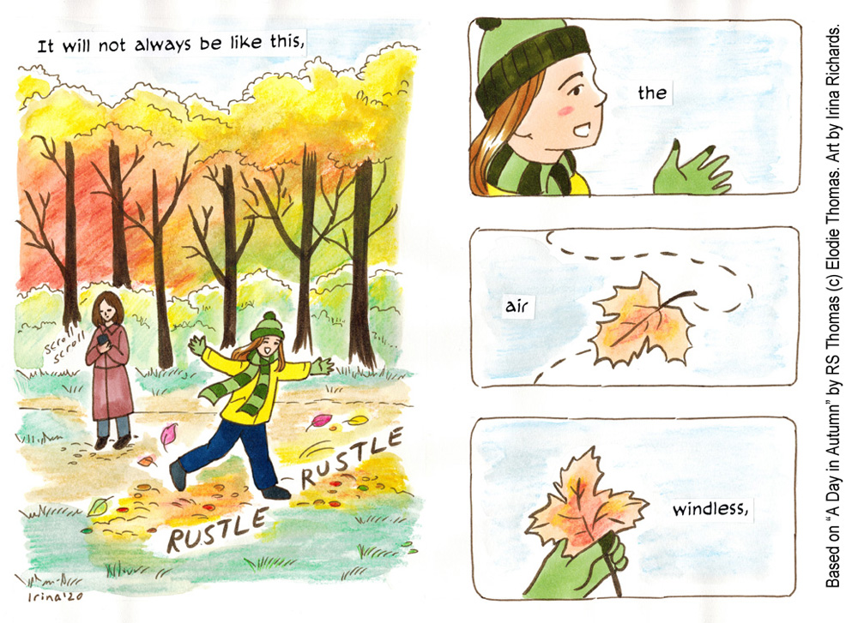
Key vocabulary:
Illustration, Inspiration, Interpretation, Original Source, Respond, Response,
Graphic Novel, Illustrator, Poetry, Prose, Stage, Arrange, Line, Quality of line, Line Weight, Mark Making, Medium, Graphite, Ink, Pen, Quill, Brush, Watercolour, Water-soluble, Composition, Sequencing, Visual Literacy,
KS2 Art
Storytelling through Drawing
Knowledge Organiser
Key Concepts:
That we can tell stories through drawing.
That we can use text within our drawings to add meaning.
That we can sequence drawings to help viewers respond to our story.
That we can use line, shape, colour and composition to develop evocative and characterful imagery.
Medium: Drawing Materials, Paper
Curriculum Links
English: Use The Jabberwocky by Lewis Carol as inspiration for this pathway, or choose another story or graphic novel of your choice.
History: Create your own sequenced story inspired by an event in history ie from The Anglo Saxon, The Viking, Ancient Greeks, Ancient Egyptian or The Roman eras.
Science: Use language to support concepts around light and shadow, and how this can be explored on paper through drawing.
PSHE: Supports Collaboration, Peer Discussion.
Artists:
Laura Carlin, Shaun Tan
Themes: Children explore how we can create sequenced imagery to share and tell stories

