Slide 1
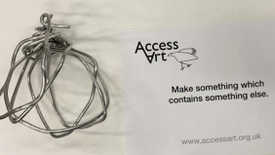
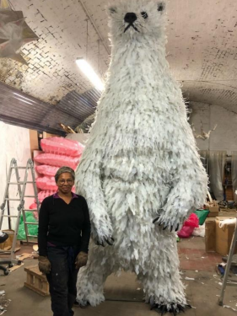
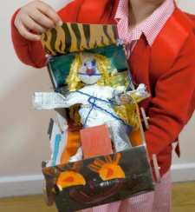
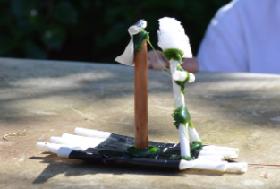
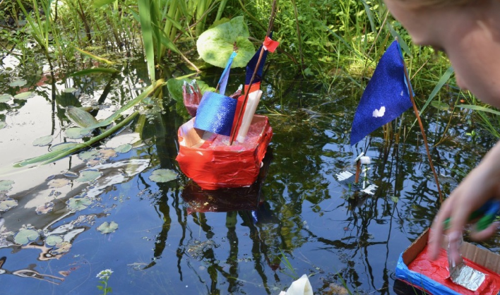
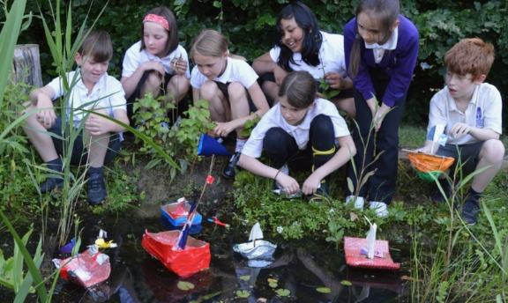
Lesson 1 – Introduce the idea of "Sculpture"
Sculpture,
Sculptor,
Three
Dimensions
Lesson 2 –
Start Making
Explore materials and tools
Respond, Response
Knowledge Organiser
Lesson 3 – Boats That Float & Sea Creatures
Design Through Making,
Playful Making,
Explore, Construction,
Materials,
Lesson 4
“What makes a boat float?”
Invent,
Imagine
Lesson 5 – Making…
Tools,
Construct,
Structure,
Balance
Lesson 6 – Reflect & Discuss
Finished boat! Ready to float?
Reflect, Share, Discuss
KS1 Art
Playful Making

