Slide 1
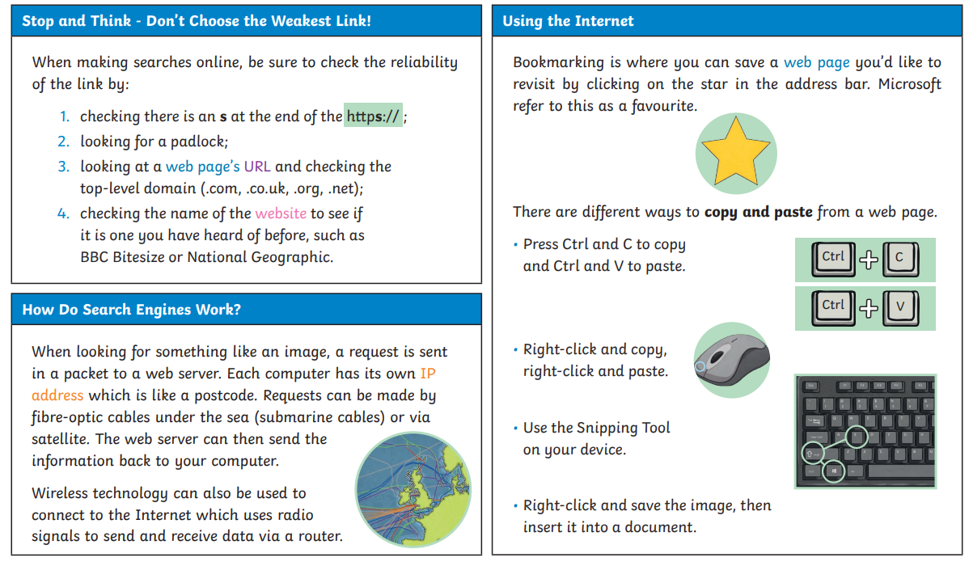
Knowledge Organiser
LKS2 Connecting Computers – Autumn Term
Key Concept:
Understand the relationship between inputs, processes, and outputs and apply it to devices and parts of devices that you will be familiar with from your everyday surroundings.
Progression
Develop knowledge and understanding of digital and non-digital devices, and introducing the concept of computers connected together as a network.

Slide 2
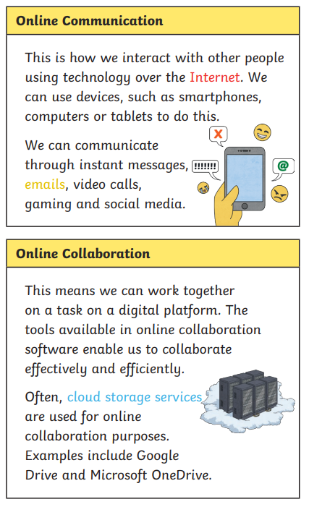
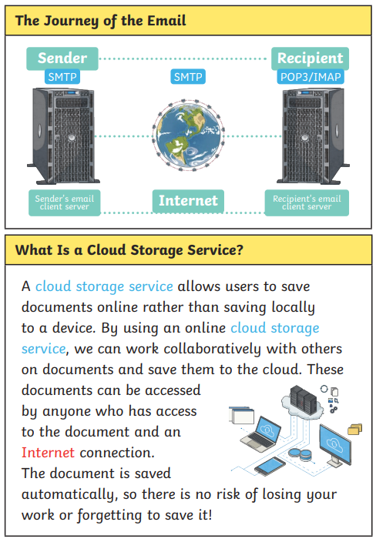
Knowledge Organiser
UKS2 Connecting Computers – Autumn Term
Key Concept:
Understand the relationship between inputs, processes, and outputs and apply it to devices and parts of devices that you will be familiar with from your everyday surroundings.
Progression
Develop knowledge and understanding of digital and non-digital devices, and introducing the concept of computers connected together as a network.

