Slide 1

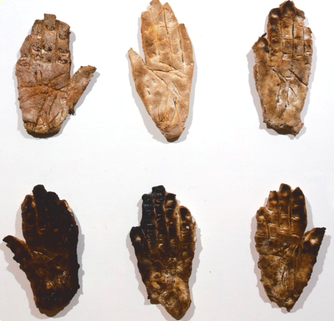
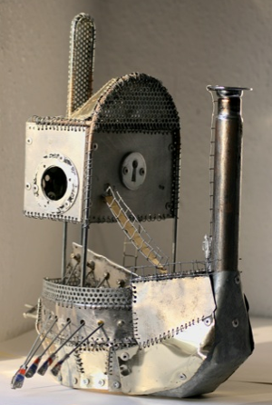
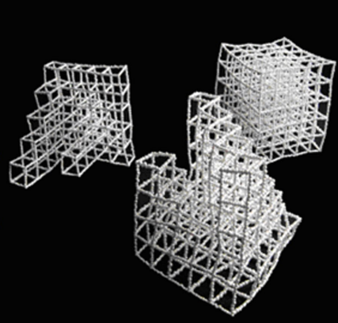
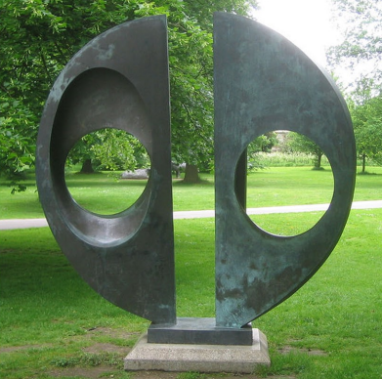
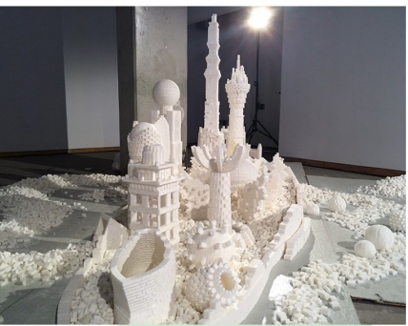
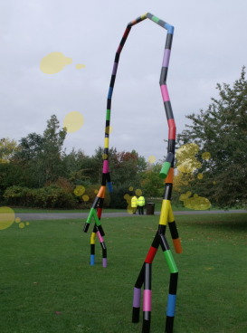
Knowledge Organiser – Art – Summer 2026 – Let’s Sculpt (Key Stage 1)
Sticky Knowledge - What I already know
I know how to join items in a variety of ways e.g. tape, glue.
I know how to build models of real-life things such as buildings and vehicles using a variety of resources.
I know how to use malleable materials e.g. moon sand, play dough.
Core Learning
To know how to use bread dough to make a sculpture
To know how to sculpt a monster from recycled materials
To know how to create an abstract sculpture of a person
To know how to create sculptures with different materials (spoons)
To know how to use sugar cubes to create a sculpture of a building
To know how to make a sculpture using line, shape, form and space

Slide 2
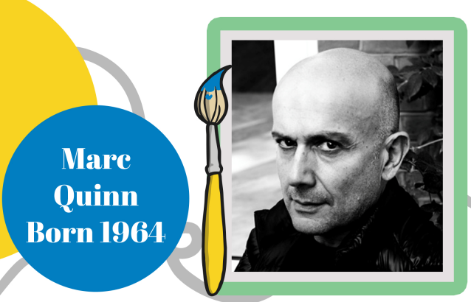
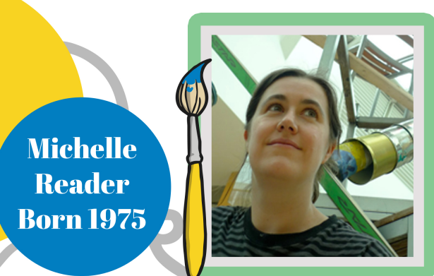
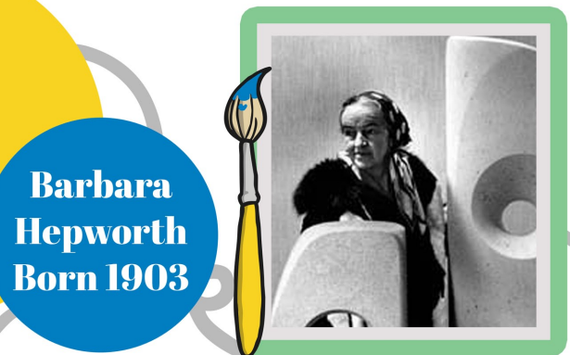
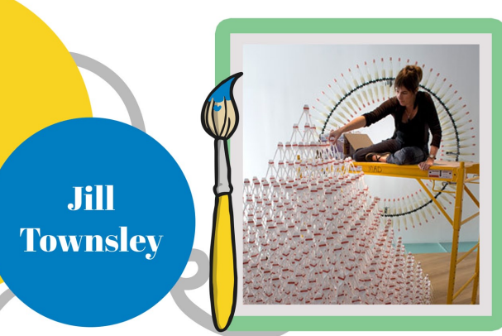
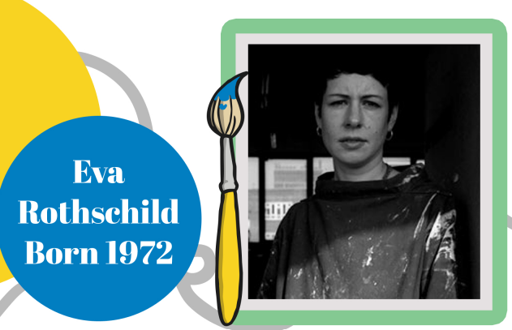
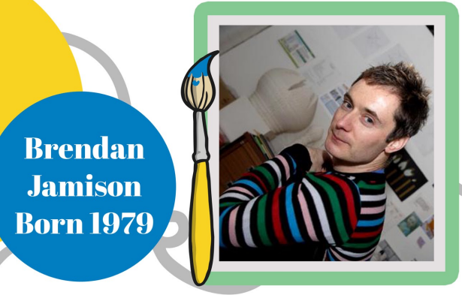
Artist Focus

Slide 3
Let’s Sculpt Vocabulary
Word | Definition
Sculpture | A sculpture is art that I can walk around and see all sides of.
Statue | A statue is a sculpture that looks like a person or an animal.
Abstract | Abstract art does not look real and is made with shapes and ideas.
Carving | Carving is when I cut or shape a material to make art.
Construct | To construct means I stick or join pieces together to make a sculpture.
Geometric | Geometric means using shape names like circle, square, and triangle.
Installation | An installation is art that is made to fill a space, like a room or hall.
Manufactured Materials | Manufactured materials are made by people, not nature.
Natural Materials | Natural materials come from nature, like wood, stones, or leaves.
Sculptor | A sculptor is a person who makes sculptures.
Texture | Texture is how something feels or looks like it feels, such as rough or smooth.

