Slide 1


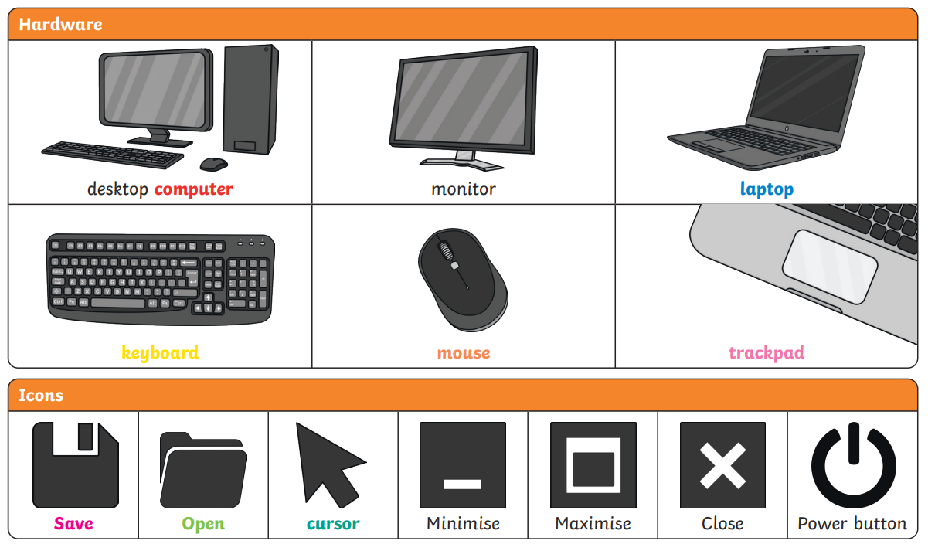
Knowledge Organiser
Year 1 Technology around us – Autumn Term
Key Concept:
You will begin to use the computer keyboard for a purpose.
You will then save your work using the save icon and understand that this icon is used in lots of different programs.
Progression
You will build your knowledge of parts of a computer and develop the basic skills needed to effectively use a computer keyboard and mouse.

Slide 2
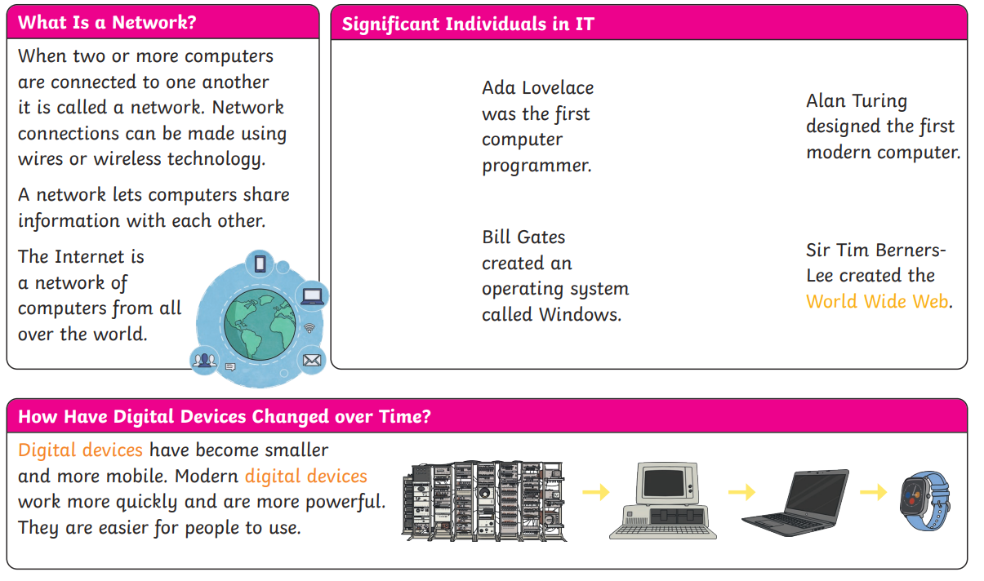
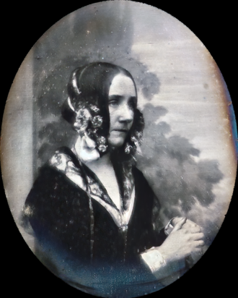


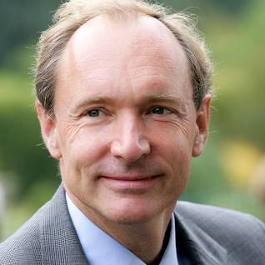
Knowledge Organiser
Year 2 Technology around us – Autumn Term
Key Concept:
You will begin to use the computer keyboard for a purpose.
You will then save your work using the save icon and understand that this icon is used in lots of different programs.
Progression
You will build your knowledge of parts of a computer and develop the basic skills needed to effectively use a computer keyboard and mouse.

