Slide 1








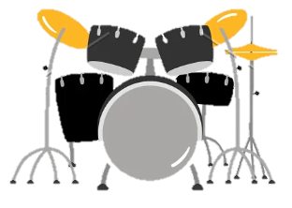
Music at the
Acorn Federation
Our Curriculum
Our Music curriculum is based on the Charanga scheme that follows the National Curriculum 2014. The different areas of the scheme are then adapted to suit the mixed class structure we have in our schools.
Our strengths and areas for development in Computing
Sequencing of the lessons is structured and builds on prior skills and knowledge
Children are given opportunities to explore new genres and cultures of music.
At the start of all lessons, the Knowledge Organiser and key vocabulary is discussed – which consolidates the learning and skills used previously and which new skills will be developed further.
Children are given time to reflect and adapt their learning at the end of every session.
Areas for development
Embed all three units of work throughout a full academic year (Started this cycle December 2022)
Evaluate the impact of the scheme after it’s initial trial
Provide opportunities for staff to see the Music lead deliver a lesson
Unit Structure
All units of work in Music is broken down into three specific areas:
Quality First Teaching
Before each unit starts, staff shares a copy the Knowledge Organiser.
Each unit has a particular theme and covers the three specific areas, gradually building on previous skills learnt.
At the beginning and end of each unit the children perform a specific “themed” song. This is used as an assessment opportunity to monitor the children's progress.
Listening and Appraising
Musical Activities
Assessment in Computing
At the beginning and end of each unit the children perform a specific “themed” song. This is used as an assessment opportunity to monitor the children's progress.
At the end of each unit staff complete the matching assessment grid. This is then shared with the Music lead.
The Music lead uses this to inform the planning of future units making sure that all the children's needs are met.
Music lessons
We make our Music lessons as practical as we can. The children get time to explore
different musical experiences.
Perform & Share
03/05/23

