Slide 1
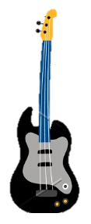
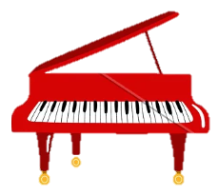
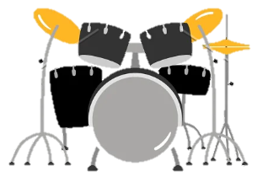
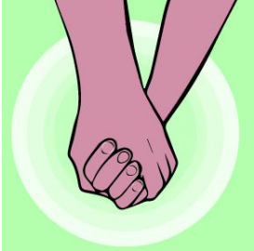
KS2
Vocabulary
Keyboard, drums, bass, pentatonic scale, pulse, rhythm, pitch, tempo, dynamics, texture structure, compose, improvise, hook, melody
Listen and Appraise
Instruments/voices you can hear: Keyboard, drums, bass, a female singer.
Do the words of the song tell a story?
Does the music create a story in your imagination? What story?
Musical Activities
Warm-up games
Singing in 2 parts
Play instrumental parts with the song
Improvise using up to 3 notes
Compose a simple melody
Perform & Share
What did you like best about this Unit? Why?
Was there anything you didn’t enjoy about it? Why?

