Slide 1
Support in the summer holidays
From your
5-19 Public Health Nursing Team

Slide 2
Did you know public health nurses are available, if you need support in the school holidays ?

Slide 3
Gender & sexuality
Drugs & alcohol
Body image
Sleep
Smoking & vaping
What do we do?
Puberty
General health
Emotional health & anxiety
Young carers
Relationships & friendships

Slide 4
How to contact us
Use our Chat health service to chat to us or request an appointment.
We can offer appointments at locations in the area such as a health centre, visit you at home or community walks.

Slide 5
Hot Tips for Summer…
Remember to wear sunscreen, hats and stay hydrated
It’s tempting to get in open water, rivers and streams, when it’s hot. Be aware of objects under the water, cold water shock and drowning. Remember to relax and float.
Stay safe when out and about in the community and look after each other.

Slide 6
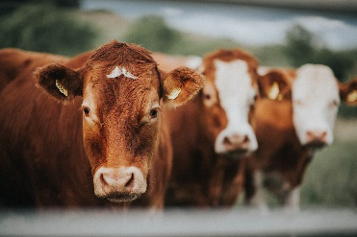
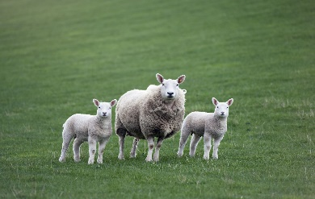
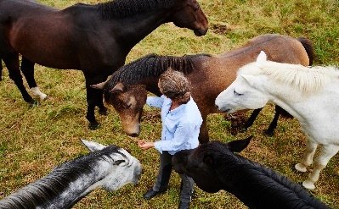
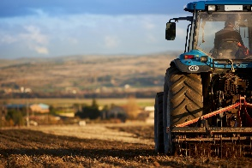
Rural safety
If you live on a farm, work on a farm or with animals or horses remember safety first.
Wear protective equipment when provided.
If working near or operating farm machinery or vehicles take extra care.

Slide 7
Animals can be unpredictable, so handle with care and wear protective boots and riding hats when riding and handling horses.
Let an adult know your location and whereabouts, length of time you will be, if you plan to be doing an activity on your own.
Farms can be busy places, especially during harvest and silage, so always be aware of fast-moving machinery and don’t take unnecessary risks.

Slide 8
Most importantly….
Have fun, makes lots of memories and have a great summer.
From the 5-19 public health nursing team

Slide 9
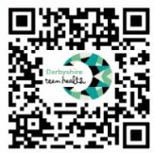
Contact us…
TEXT CHAT Health on 07507 330025
(11-19 years)
@Derbysteenhealth
@Derbysfamilyhealth
Scan the QR code to visit our website
www.derbyshireteenhealth.nhs.uk

