Slide 1
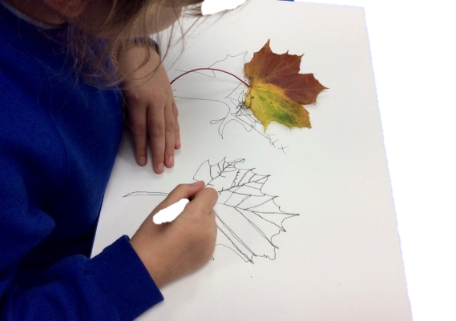
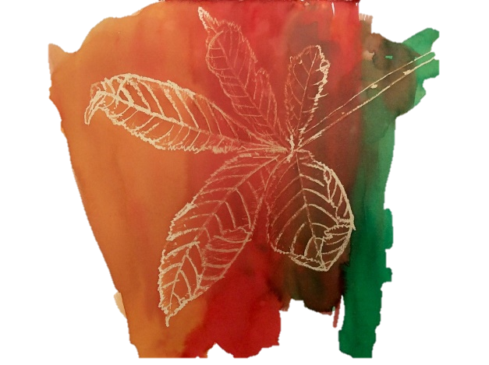
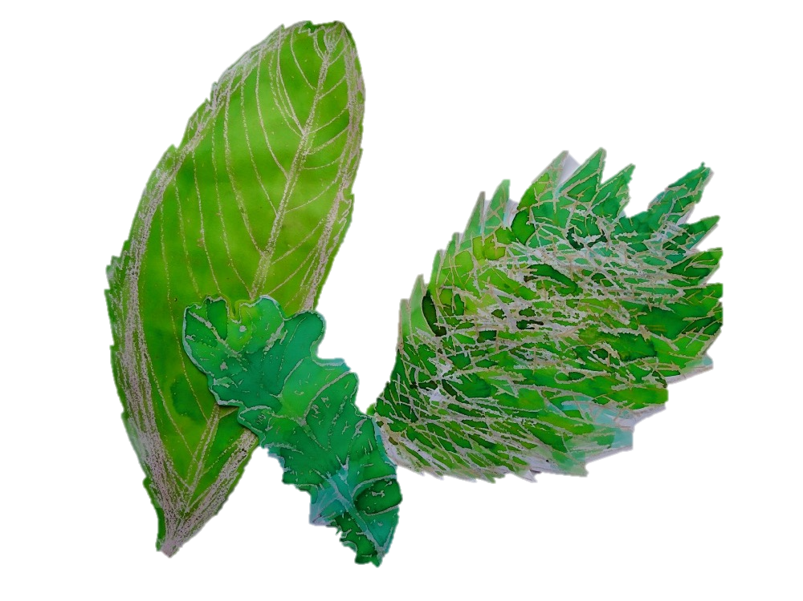
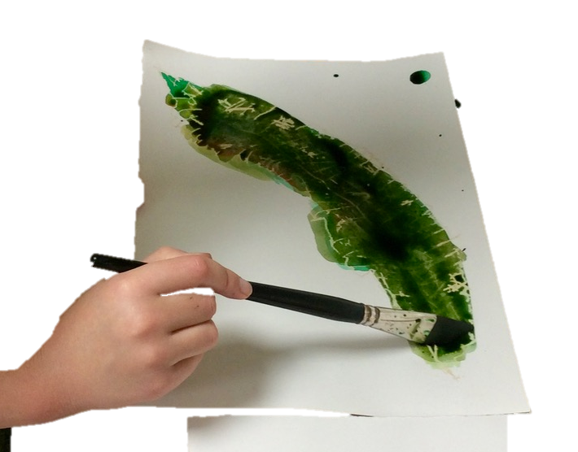
Key vocabulary:
Explore, Collect, Re-See, Imagine, Curious, Present, Re-present, arrange, composition, Photograph, Focus, Light, Shade, Colour, Pattern, Observational Drawing, Close study, Draw slowly, Intention, Pressure, Line, Mark, Page, Sense of Touch
KS1 Art
Explore and Draw
Knowledge Organiser
Key Concepts:
That artists explore the world, seeing things around them in new ways, and bring things back to their studios to help them make art.
That we can go into our own environments, even when they are very familiar to us, and learn to see with fresh eyes and curiosity.
That we can use the things we find to draw from, using close observational looking.
Medium: Graphite, Handwriting Pen, Watercolour / Brusho, Wax Resist
Curriculum Links
Geography: Adapt to explore habitats.
Maths: Use language to develop understanding of patterns, sequence, symmetry, pictorial representation, repetition.
Science: Identifying common and wild plants, trees, structures of plants, exploring local environments and habitats, seasons, planting and growing.
PSHE: Peer discussion, Collaboration.
Artists:
Rosie James, Alice Fox
Themes: Natural Forms, Seasonal Changes, Patterns, Symmetry

