Slide 1



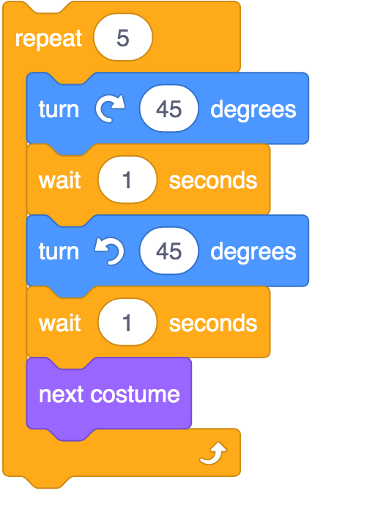
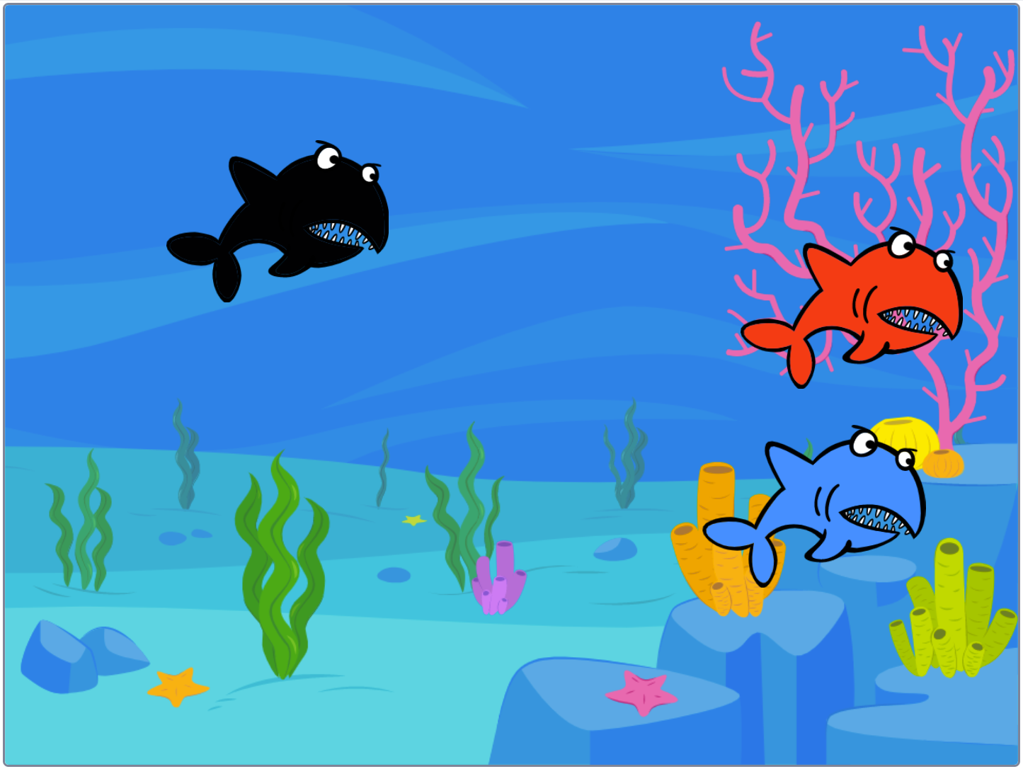


Lesson 1
To develop the use of count-controlled loops in a different programming environment
Scratch, programming, sprite, blocks, code, loop, repeat, value
Lesson 2
To explain that in programming there are infinite loops and count-controlled loops
Block, repeat, forever,
infinite loop, count-controlled
loop, costume
Knowledge Organiser
Lesson 3 - To develop a design that includes two or more loops which run at the same time
Repetition, forever, infinite loop, count-controlled loop, animate, costume, event block, duplicate
Lesson 4
To modify an
Infinite loop in
a given program
Block, repeat,
forever, infinite loop,
modify, design
Lesson 5
To design a project that includes repetition
Infinite loop,
count-controlled loop,
repetition, design,
sprite, algorithm
Lesson 6 – To create a project that includes repetition
Repetition, design, algorithm, question
duplicate, debug, refine, evaluate
KS2 Programming
Summer Term

Slide 2
Lesson 1
To develop the use of count-controlled loops in a different programming environment
Scratch, programming, sprite, blocks, code, loop, repeat, value
Lesson 2
To explain that in programming there are infinite loops and count-controlled loops
Block, repeat, forever,
infinite loop, count-controlled
loop, costume
Knowledge Organiser
Lesson 3 - To develop a design that includes two or more loops which run at the same time
Repetition, forever, infinite loop, count-controlled loop, animate, costume, event block, duplicate
Lesson 4
To modify an
Infinite loop in
a given program
Block, repeat,
forever, infinite loop,
design
Lesson 5
To design a project that includes repetition
Infinite loop,
count-controlled loop,
repetition, design,
sprite, algorithm
Lesson 6 – To create a project that includes repetition
Repetition, design, algorithm,
duplicate, debug, refine,
LKS2 Programming
Summer Term

Slide 3
Lesson 1
To develop the use of count-controlled loops in a different programming environment
Scratch, programming, sprite, blocks, code, loop, repeat, value
Lesson 2
To explain that in programming there are infinite loops and count-controlled loops
Block, repeat, forever,
infinite loop, count-controlled
loop, costume
Knowledge Organiser
Lesson 3 - To develop a design that includes two or more loops which run at the same time
Repetition, forever, infinite loop, count-controlled loop, animate, costume, event block, duplicate
Lesson 4
To modify an
Infinite loop in
a given program
Block, repeat,
forever, infinite loop,
modify, design
Lesson 5
To design a project that includes repetition
Infinite loop,
count-controlled loop,
repetition, design,
sprite, algorithm
Lesson 6 – To create a project that includes repetition
Repetition, design, algorithm, question
duplicate, debug, refine, evaluate
UKS2 Programming
Summer Term

