Slide 1


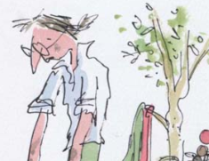
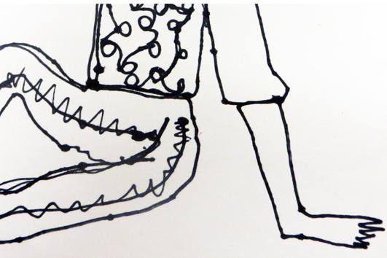
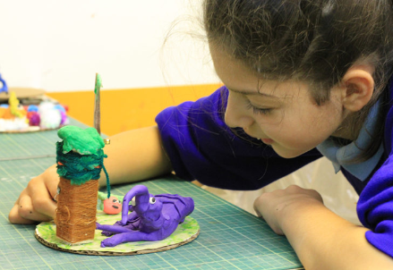
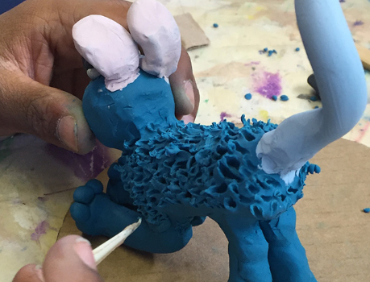
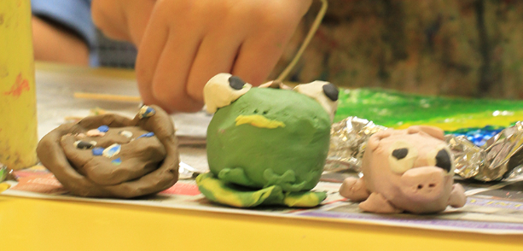
Lesson 1 – Using Quentin Blake's Drawings as Inspiration!
Sketchbooks,
Brainstorm,
Explore, Experiment,
Test, Try Out
Lesson 2 – Simple continuous line drawing.
Respond
Response
Knowledge Organiser
Lesson 3 – Creating illustrations of characters showing movement and expression.
Line, Shape, Wash, Layer, Pen, Watercolour, Exaggerate, Gesture
Lesson 4 – Plasticine Characters
Sculpture,
Armature,
Structure, Cover,
Construct,
Model,
Character, Personality
Lesson 5
Adding texture
to the model
Present, Share,
Reflect, Respond, Feedback
Lesson 6 – Reflect & Discuss
How do I feel about what I have made?
Photograph, Lighting,
Composition, Focus, Intention,
LKS2 Art
Telling Stories
Through Making

