Slide 1
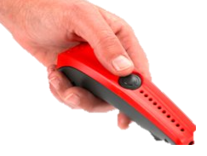
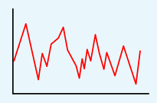
Lesson 1
Which questions can be answered with the data collected?
Data, table, layout
Lesson 2
Data Collection
How do we sense things?
What are our senses?
Input device, sensor, data logger
Knowledge Organiser
Lesson 3 - Logging
Recording the data using Excel.
Data logger, logging, data point, interval
Lesson 4
Analysing the Data.
Data logger,
logging,
data point,
interval
Lesson 5
Can you think of a question that the collected data could answer?
Data, data logger, logged, collection
Lesson 6 – Answering my Question
After data has been collected, it needs to be analysed.​
Can the question(s) be answered?​
Does the data tell us anything else?​
Analyse, review, conclusion
UKS2 Data Logging
Spring Term

