Slide 1

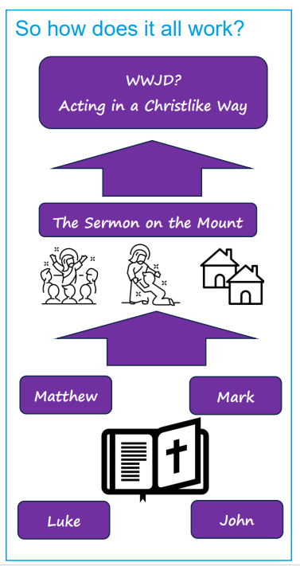
Knowledge Organiser –Christians and how to live - What would Jesus do? Spring Term 1 2025
Sticky Knowledge – What I already know
I know for Christians the holy texts are found in the bible
I know the bible is made up of lots of books
I know Jesus told special stories called parables, which are stories which have a hidden meaning
I can name some parables in the bible
I know there are ten commandments which tell Christians how to live
Key Knowledge – What I will know at the end of the unit
The word Gospel literally means good news. It is also is the title given to the four books of the Bible which tell the story of the life of Jesus.
Three of the gospels are similar, these are the Gospels of Matthew, Mark and Luke. They wrote about the life of Jesus using eyewitness accounts. The Gospel of John is very different to the other three.
People who study theology look at the interpretation or meaning of what these four wrote.
The gospels contain the parables that Jesus told and how he told people to live known as commandments.
The gospels contain the two great commandments of Jesus that tell Christians how to live. He also gave The Sermon on the Mount to tell people how to live. Jesus would show that the good news was for everyone including those people in society many did not like. An example of this was Jesus healing people with leprosy, a disease that people were sacred of.
You will often see people wearing things with the letters WWJD on them, this means they are thinking ‘What would Jesus do?’ By following what Jesus taught in the commandments, in his action’s and in the parables they hope to become more Christlike.

Slide 2
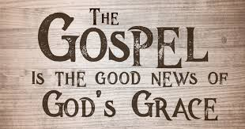
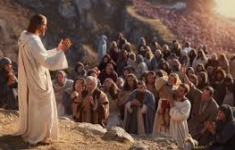
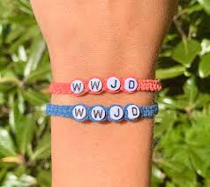
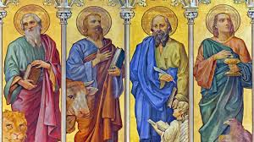
Key Vocabulary | Definition
Gospel | this literally means ‘Good news’ but also the title of the four books of the bible that tell the story of the life of Jesus
sermon | a kind of speech that a religious leader gives during a religious service
Luke | one of the three gospels which are similar in the New Testamen
Matthew | one of the three gospels which are similar in the New Testament
Mark | one of the three gospels which are similar in the New Testament
Interpretation | a way of explaining one meaning of something.
Leprosy | a bacterial infection that damages the nerves
Christlike | becoming more like Jesus in how people act
Parables | a story Jesus told that has a special meaning
Commandments | a rule which has to be observed
Charity | when we give up something of our own in the hope that we are able to help somebody else.

